Slide 1

Team Details
Team : Butterflies
Team Members’ Name:
1.Poornimaraj GR
2.Yuvasree.S
3.Sanghamithra.J
4.Shujitha Rani.A
College Name: Chennai institute of technology

Slide 2
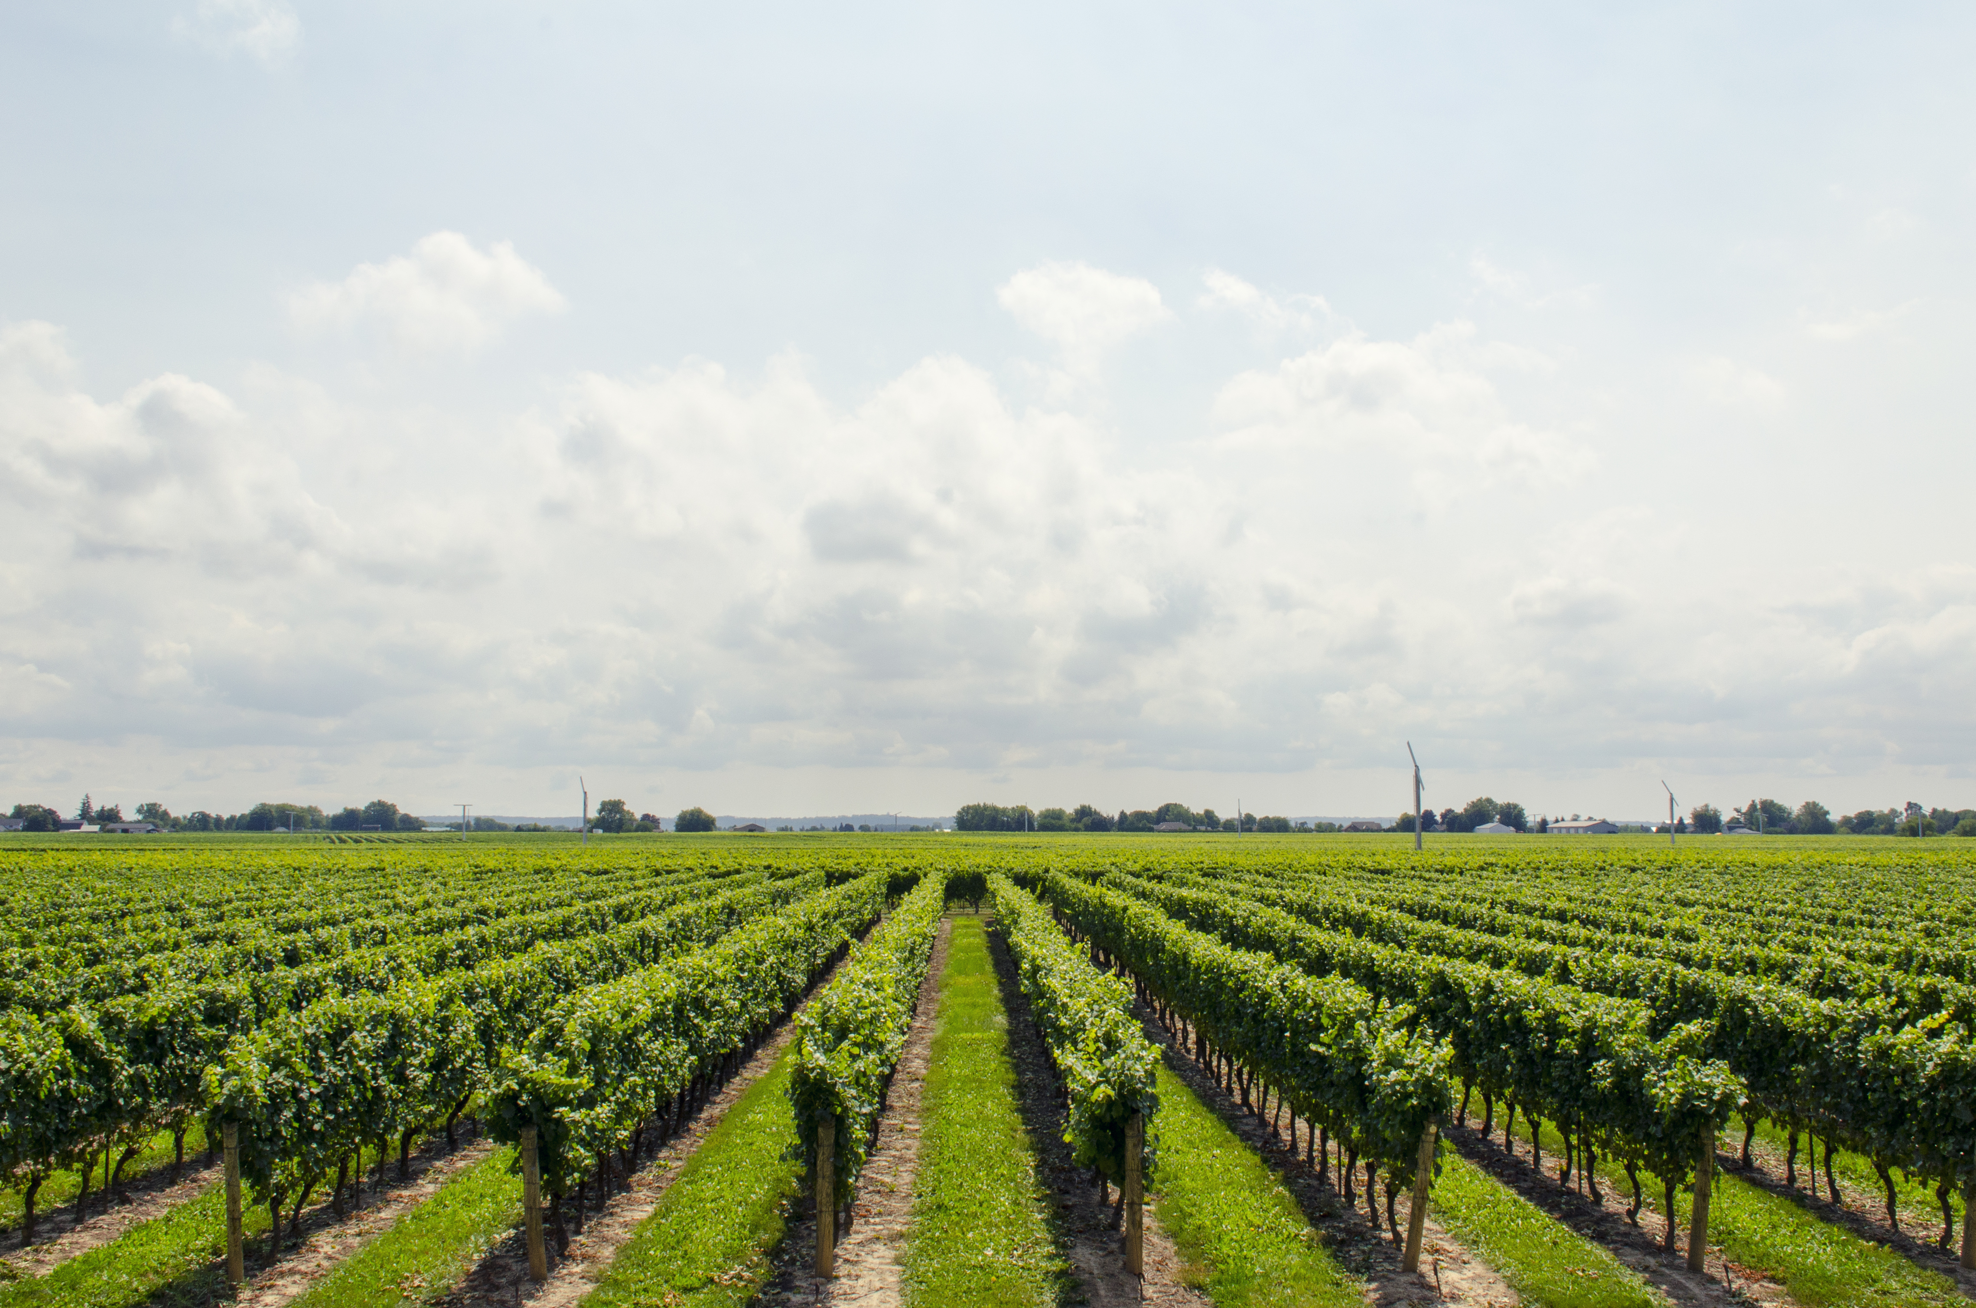
Problem Details
Problem statement: Smart plant growth system.
Problem Description : The idea is to check the quality of water and quality of soil using sensors and recommending suitable crops for better growth.
Problem Statement:
Notes:
Problem statement: Smart plant growth system

Slide 3
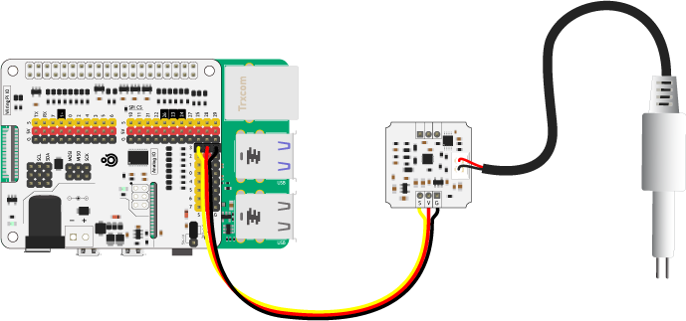
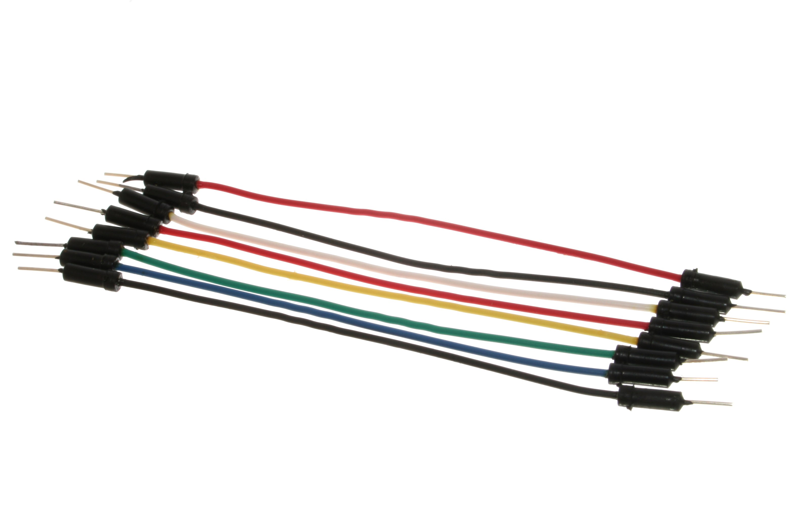
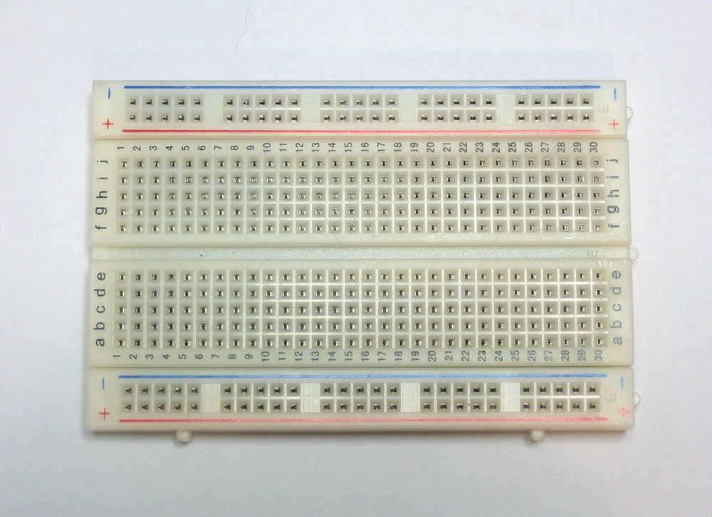
Technology stack
Sensors
1.TDS sensor
2.Soil moisture sensor
3.NPK sensor
Power supply board
ESP 32
5 volt adapter
Jumper wires
led’s

Slide 4
Key features of the idea:
The Nitrogen ,Potassium and Phosphorous level of the soil will be measured using the soil sensor .
These measured level is then compared with the ideal levels of the nutrients for which the soil is said to be suitable for plant growth.
The quality of water using water sensor is measured.
Comparing these data ,a suitable crop will be suggested through a web application.
This helps farmers to choose the correct crop and yield more benefit.

Slide 5
Advantages:
Currently , We only have a chemical approach for soil testing,
Smart agriculture has to be successfully implemented for betterment of farmers by checking the real time values of nutrients of soil and humidity.
Selecting the crop based on the water and soil quality will result in better yield.
This approach can be used by the general public to enter agriculture.
Conclusion:
1.The Idea seems to be simple but it consist of lot of benefits for a rural
development and agriculture.
2.When the idea is developed to a prototype lot of improvements can be made and
can successfully yield more benefit.

Slide 6
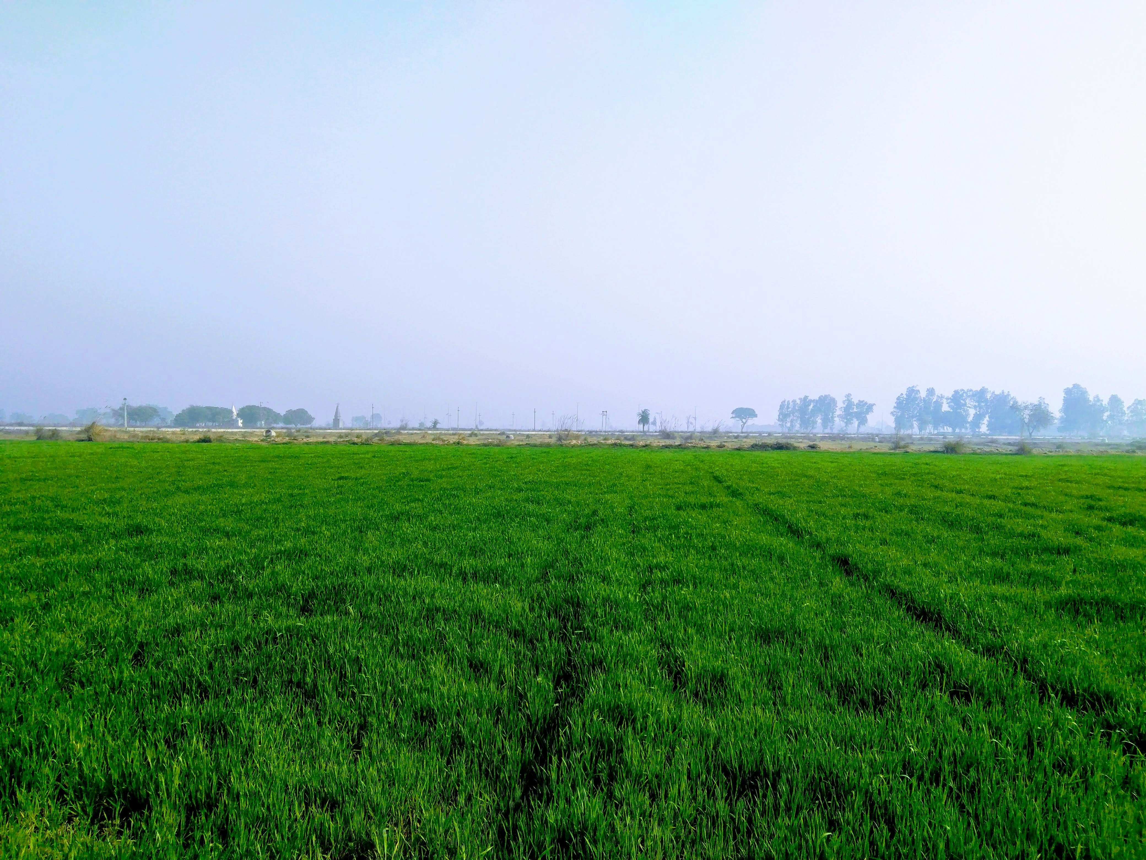
Thank you
!!!
Notes:
Thank you !!!

